Slide 1
DAPO program application
Phase-1
Layout

Slide 2
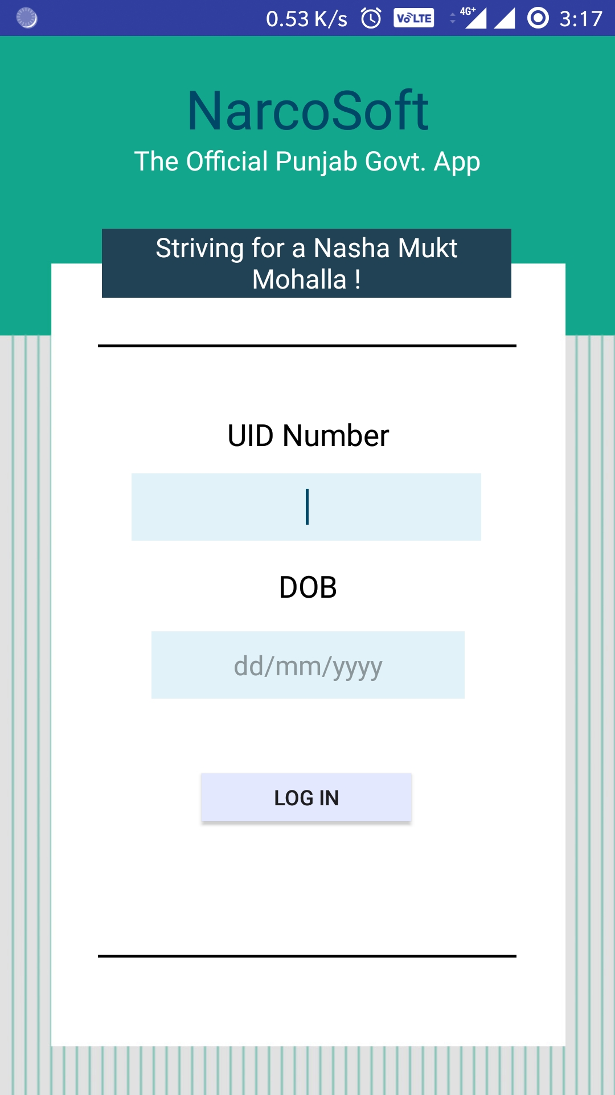
Login screen
LOGIN WILL BE DONE HERE
UNIQUE IDENTIFICATION NUMBER
DATE OF BIRTH

Slide 3
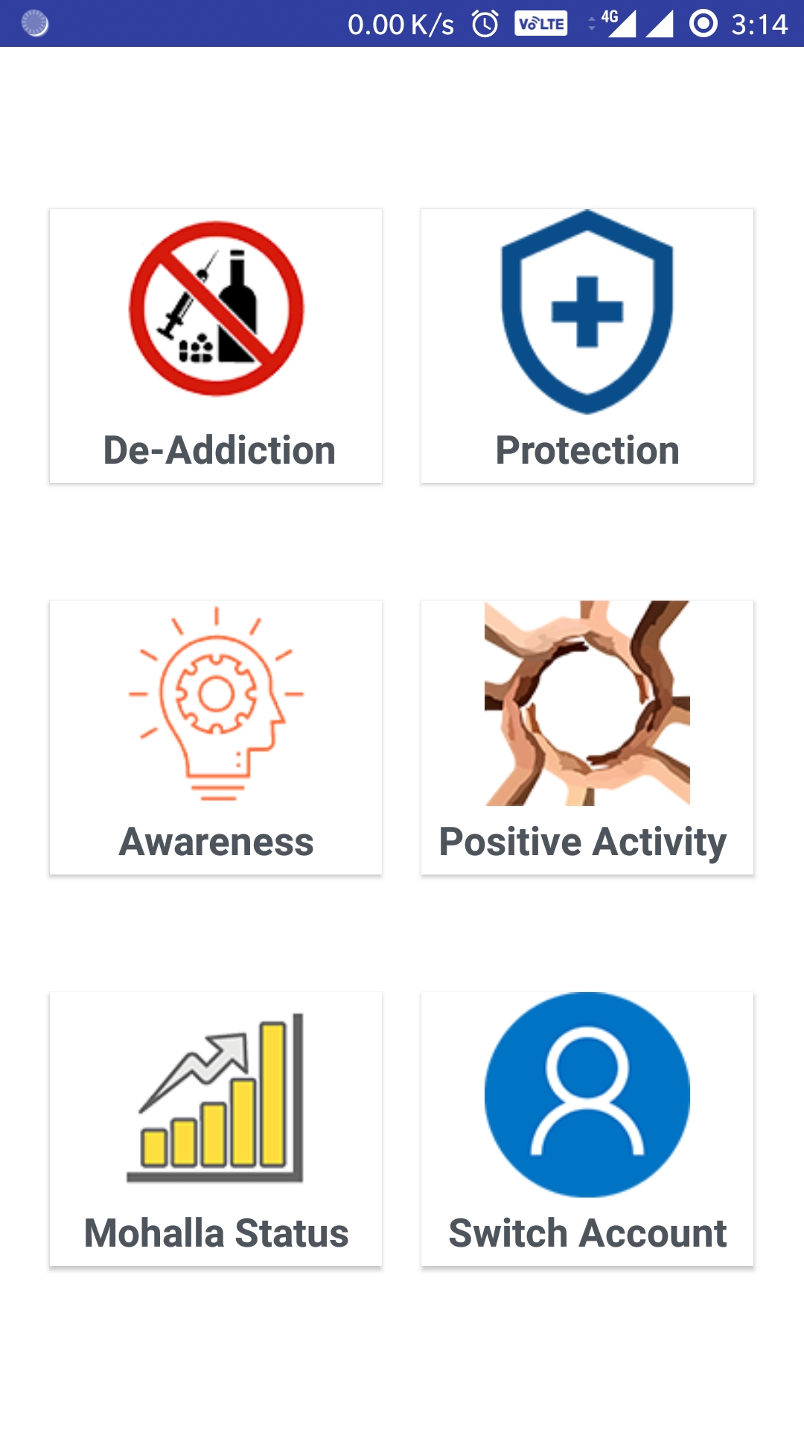
Main task page
Various subheadings available to choose for respective activity performed

Slide 4
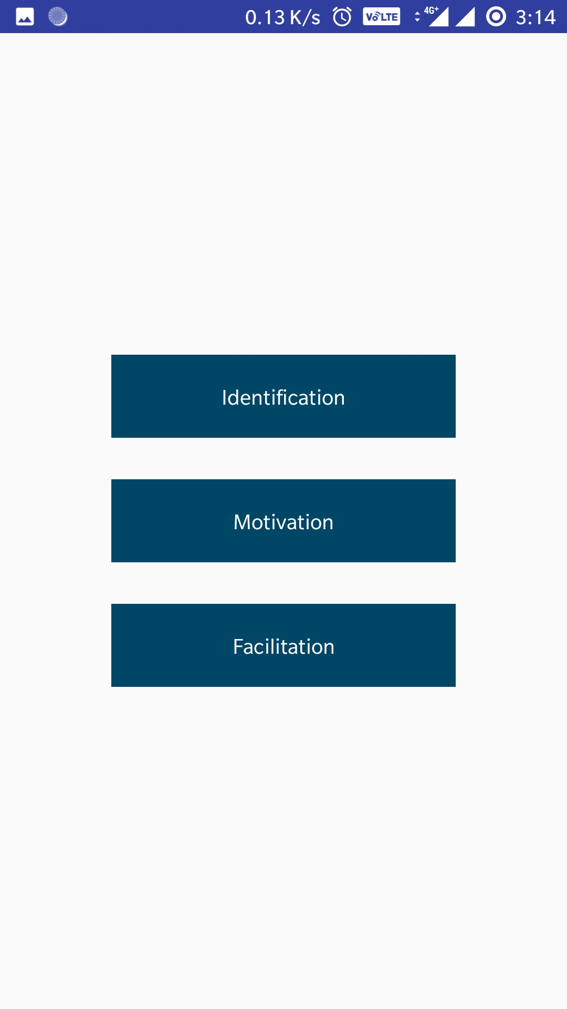
DE-ADDICTION
ACTIVITIES UNDER DE ADDICTION DIVIDED INTO 3 CATEGORIES

Slide 5
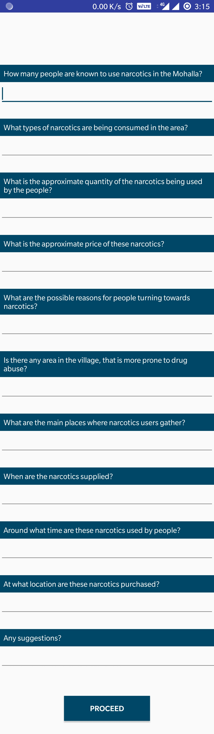
DE-ADDICTION
IDENTIFICATION
Information gathered and efforts made regarding narcotics and users

Slide 6
DE-ADDICTION
IDENTIFICATION
Information gathered and efforts made regarding narcotics and users

Slide 7
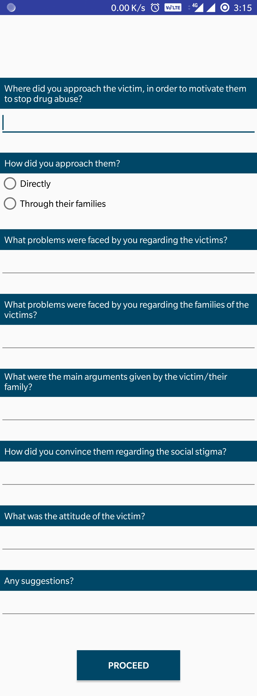
DE-ADDICTION
MOTIVATION
Efforts made to make drug users aware of the ill effects of drug abuse and to persuade them to get appropriate treatment for rehabilitation

Slide 8
DE-ADDICTION
MOTIVATION
Efforts made to make drug users aware of the ill effects of drug abuse and to persuade them to get appropriate treatment for rehabilitation

Slide 9
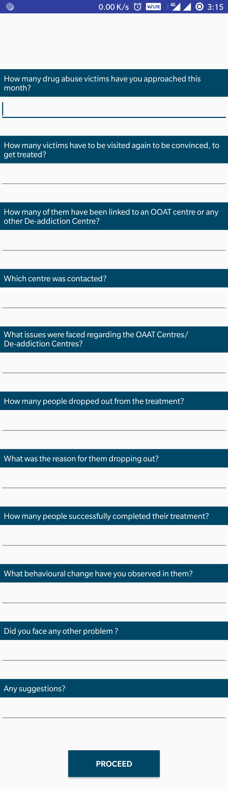
DE-ADDICTION
FACILITATION
Treatment of the drug abuse victims
Linking them to OAAT/De-Addiction Centres
Rehabilitation Details
Follow-ups on their treatment

Slide 10
DE-ADDICTION
FACILITATION
Treatment of the drug abuse victims
Linking them to OAAT/De-Addiction Centres
Rehabilitation Details
Follow-ups on their treatment

Slide 11
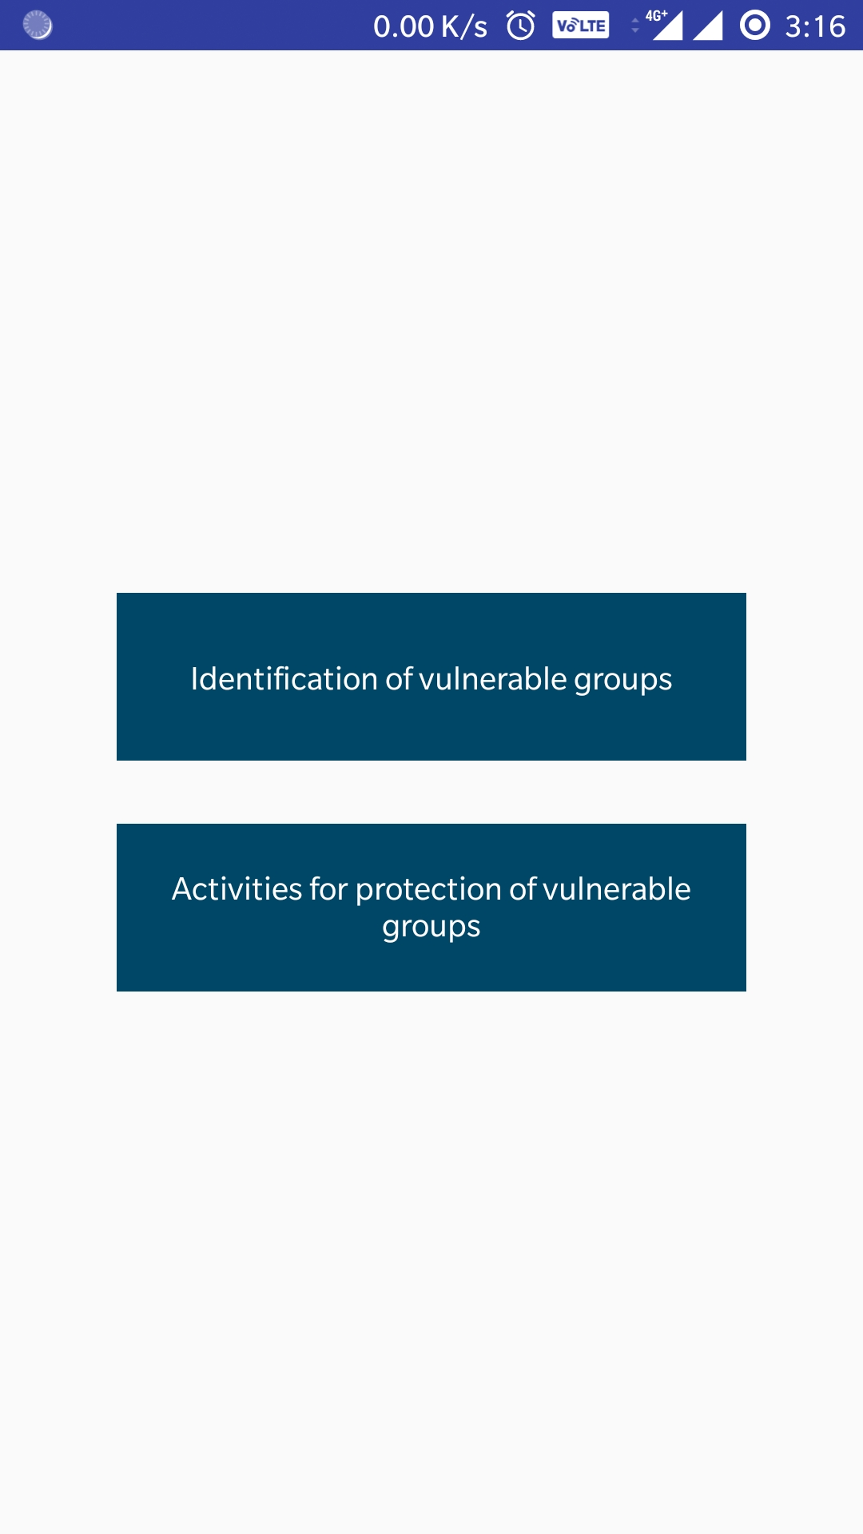
PROTECTION
Identification Of The Vulnerable Groups
Protection Of The Vulnerable Groups

Slide 12
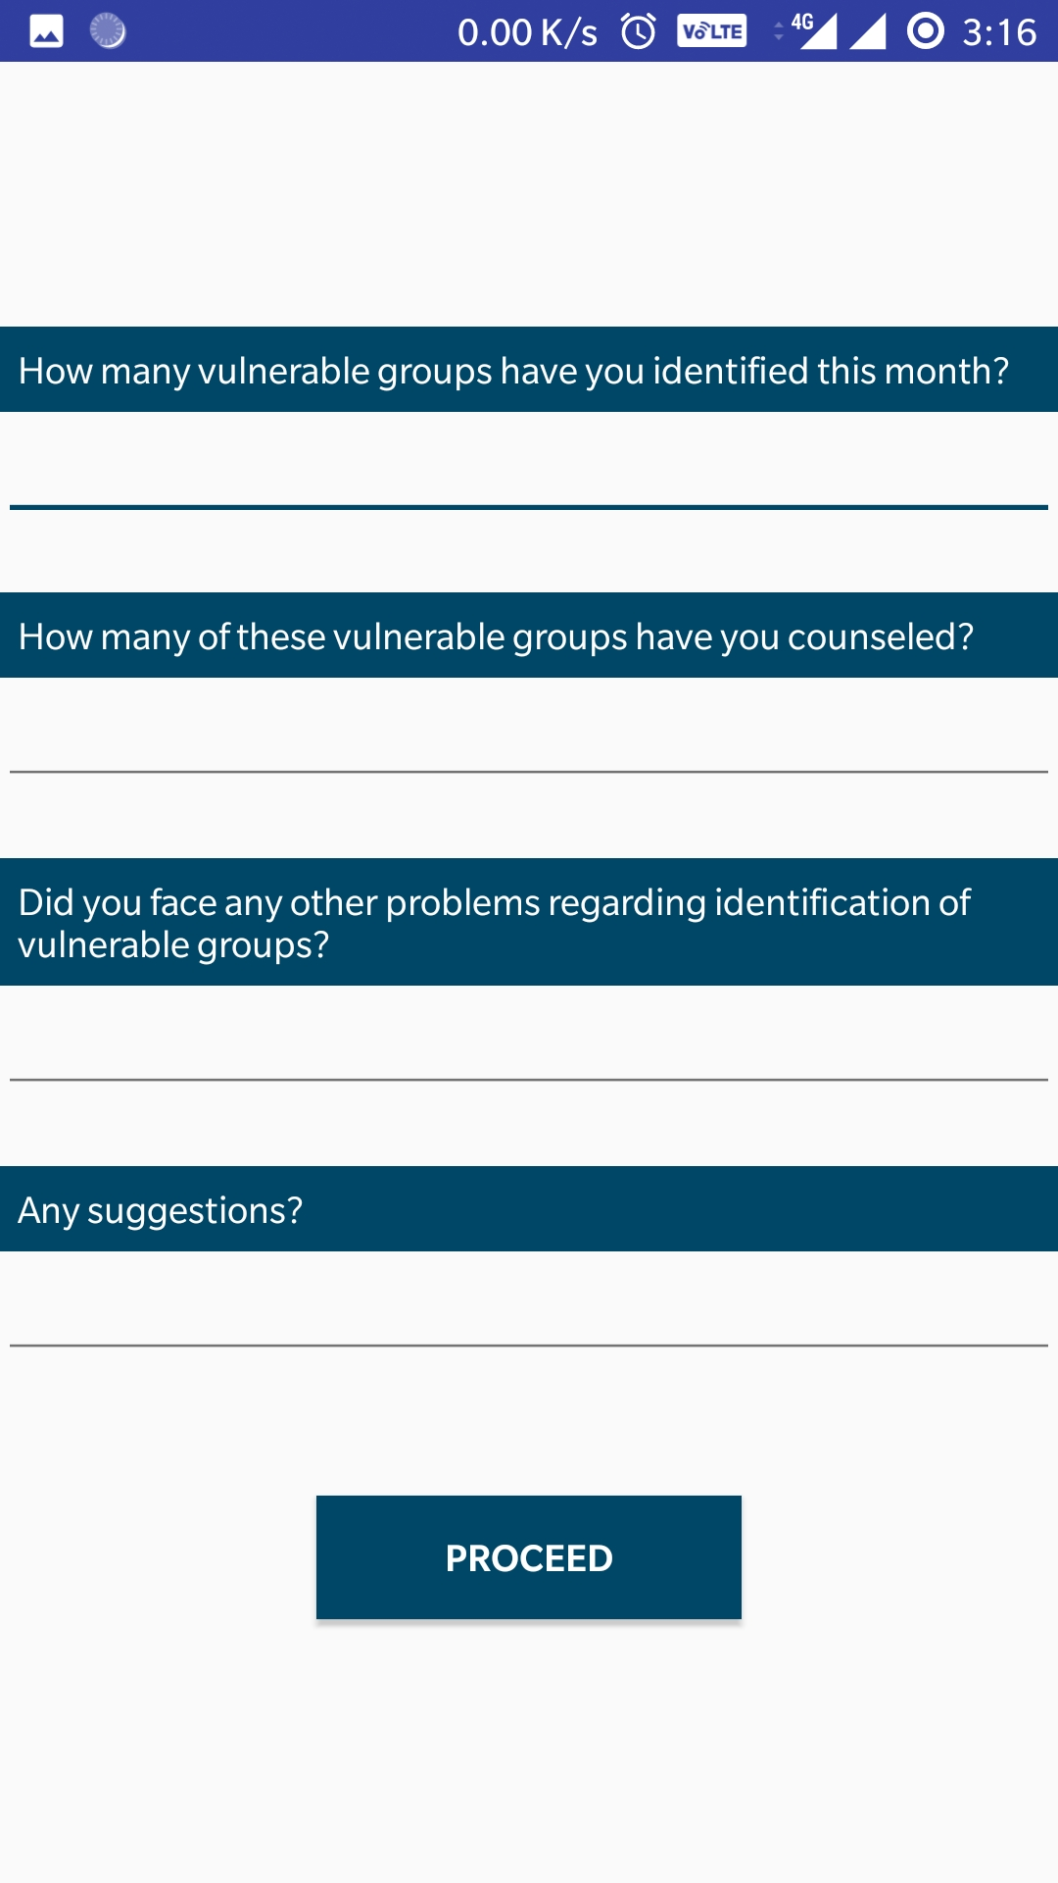
PROTECTION
Identifying potential drug users and vulnerable groups like the social circle of drug abuse victims

Slide 13
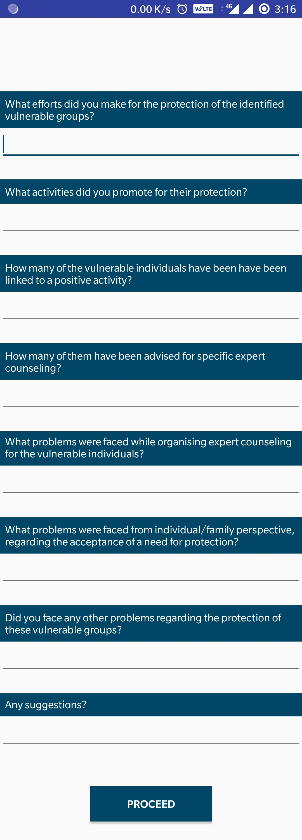
PROTECTION
Efforts made to keep said vulnerable groups away from drugs

Slide 14
PROTECTION
Efforts made to keep said vulnerable groups away from drugs

Slide 15
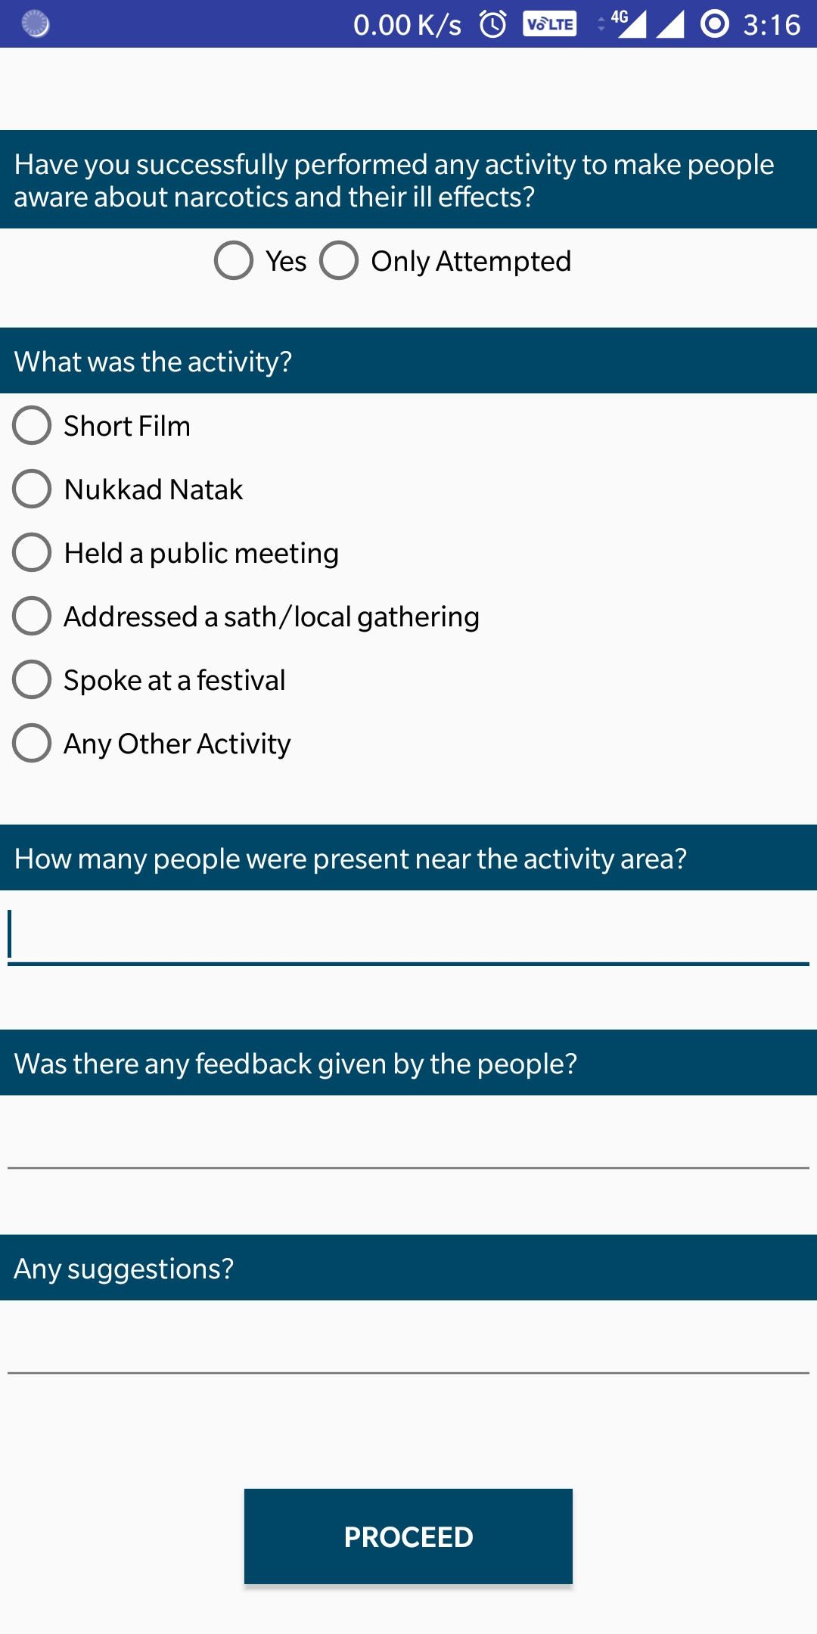
AWARENESS
Efforts made to make people aware of the ill effects of narcotics

Slide 16
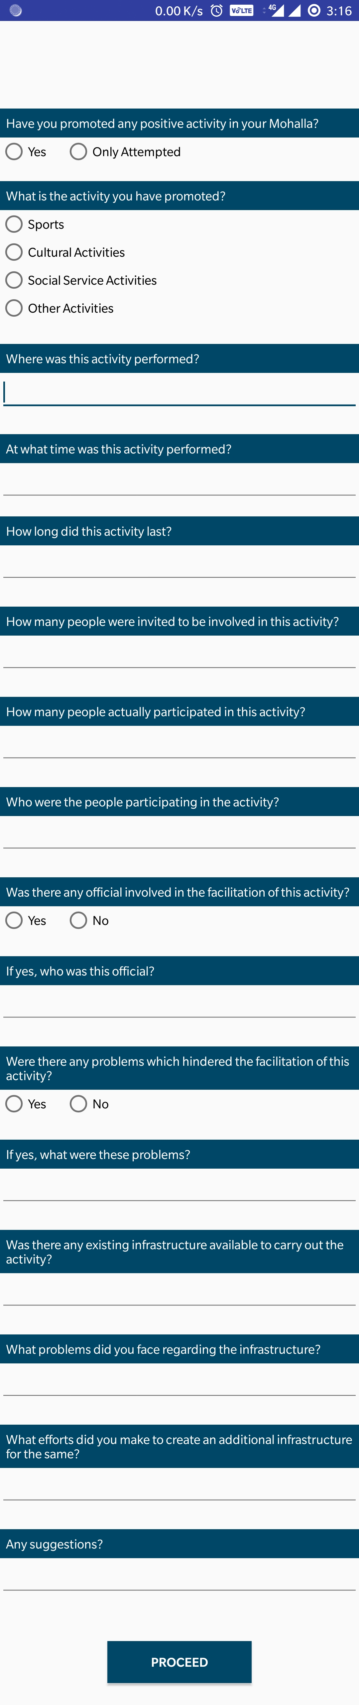
Positive activities
Efforts made to promote people’s involvement in positive activities and to keep them busy thus promoting a healthy lifestyle

Slide 17
Positive activities
Efforts made to promote people’s involvement in positiveactivities and to keep them busy thus promoting a healthy lifestyle

Slide 18
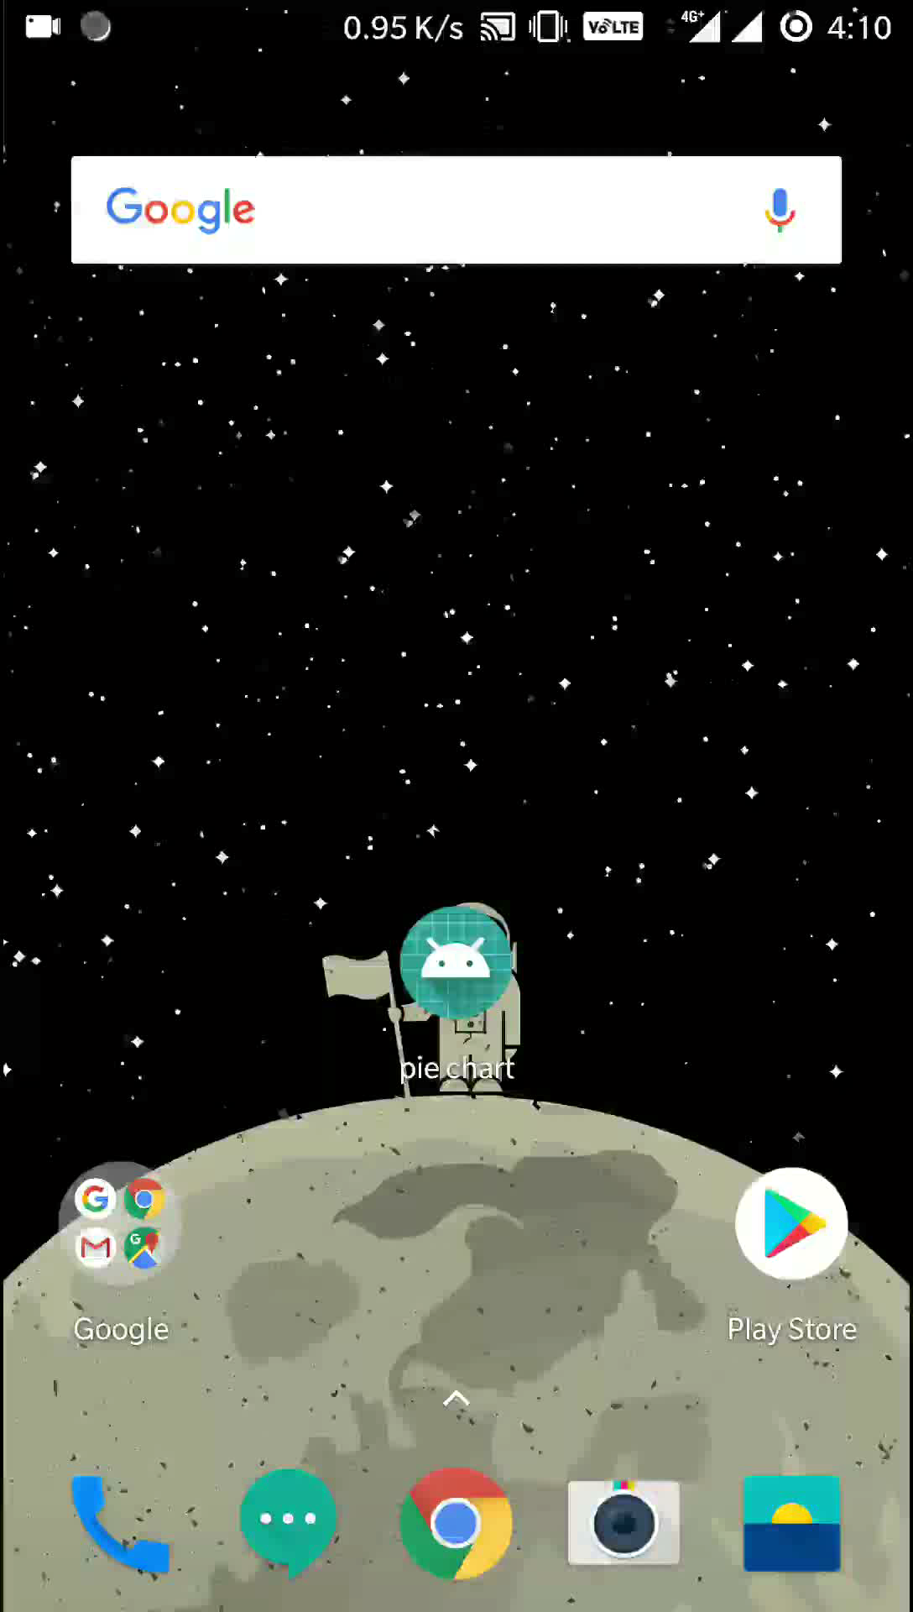
Mohalla status
UNDER WORK

Slide 19
APPS FOR HIGHER LEVELS
Corresponding apps for NRNC ,CC , SDMT , DMT and STF levels

Slide 20
Login screens

Slide 21
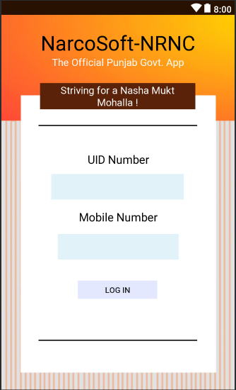
NRNC

Slide 22
CC

Slide 23
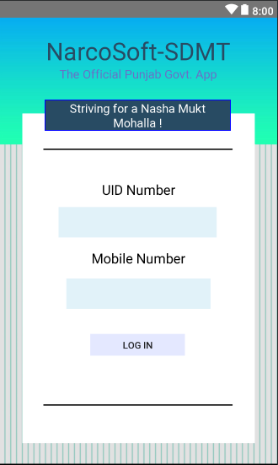
SDMT

Slide 24
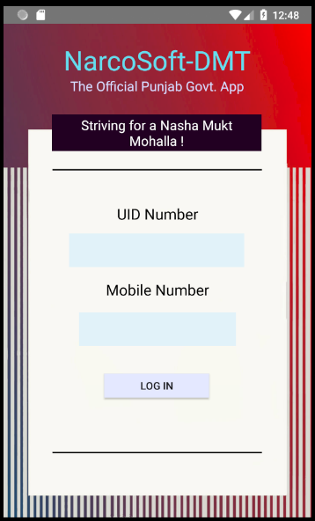
DMT

Slide 25
Special task force (stf) application
Corresponding application for use by STF

Slide 26
STF
Login Page

Slide 27
HOME PAGE
List of buttons to check the corresponding levels of hierarchy and their data

Slide 28
List of people under the hierarchal level
Corresponding list items can be clicked for respective info

Slide 29
BRIEF PROGRESS
Shortened version of DAPO’s activities

Slide 30
Detailed description
Detailed description of activities done by dapo

Slide 31
CHECK STATISTICS OF DAPO
Viewing the progress made / activities done so far by the DAPO

Slide 32
database
First ,we will have a database of registered users.
Then database of feedback form from DAPO app which will be redirected to NRNC app for evaluation
Which will then be forwarded to other hierarchies for re-evaluation.

Slide 33
Translation to Punjabi will be done soon

Slide 34
Thank you

